Slide 1

Linux Basics
I am
root!
Florentiu Ilie

Slide 2
Course Content
Course1: Startup and Shutdown +
Course2: Linux directory tree, SSH
Course3: File permissions, Environment variables +
Course4: Users, Groups, Jobs +
Course5: Processes, Logging, Archiving
Course6: Filesystems, Disk Partitioning
Course7: LVM
Course8: Backup, Useful commands
Course9: Networking
Course10: Basic Troubleshooting

Slide 3
Schedule
Initialization Test (20m) -> DONE
Course 1-2(1h each)
Test 2 (20m)
Course 3-5
Test 3 (50m)
Course 6-7
Test 4 (30m)
Project ( 7days)
Project presentation (1h each student)
Course 8-10
Test 5 (20m)
Review of all courses 1-10 (1-2h)
Final Test 1 – theoretical (1h)
Final Test 2 – practical (1-2h)

Slide 4
What is Linux ?
Linux is a free computer operating system similar to the UNIX operating system in terms of concepts, features and functionality => UNIX-like operating system
Other characteristics:
open source operating system
is similar to other operating systems you may have used before, such as Windows, OS X
has a graphical interface ( GUI ) – graphical user interface
graphical server = sub-system that displays the graphics on the monitor ( known as X server or just “X” )
Unix developed in the 1970s at Bell Labs
Linux was created in 1991 by Linus Torvalds
known products: Redhat/CentOS, Suse/Opensuse, Ubuntu, Debian
tux:
daemons = services
the shell = command process that allows you to control the computer

Slide 5
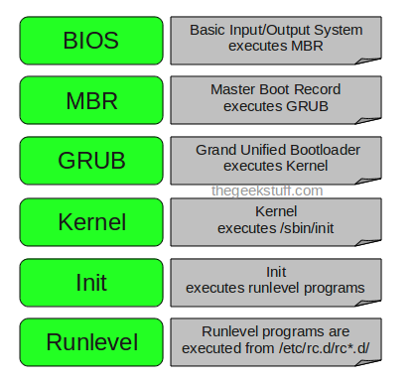
System Startup and Shutdown
Booting sequence

Slide 6
System Startup and Shutdown
System run levels
Run Level | Description
0 | Linux is down and the system is halted.
s or S | Single user state with file systems unmounted. The system can be accessed only at the system console.
1 | Single user state with all file systems mounted and SELinux activated. Mode for administrative tasks, Does not configure network interfaces, start daemons, or allow non-root logins.
2 | Multi-user state. Does not configure network interfaces or start daemons.
3 | Multi-user state. All system and network services including NFS server running. X window is not available.
4 | Not implemented.
5 | Fully operaţional multi-user state with X window and GUI desktop running. This is the default run level.
6 | Linux reboots.
emergency | Special boot mode to fix any system boot issues. The root file system is mounted in read-only mode.

Slide 7
System Startup and Shutdown
The init/systemd Process
Older versions ( bellow 6 including ) = init
New versions ( above 7 including ) = systemd
Parent process is a process that has created one or more child processes.
Child processes: This technique pertains to multitasking operating systems, and is sometimes called a subprocess or traditionally a subtask.
Procedure to create child processes:
1. fork system call ( unix systems )
2. spawn ( windows )

Slide 8
System Startup and Shutdown
The Kernel
constitutes the central core of a computer operating system
complete control over everything that occurs in the system
set of software components called modules that work together coherently as a single unit to enable programs, services and applications to run on the system
modules = device drivers
modules can be: static or dynamic
kernel with static modules = monolithic kernel, dynamic modules = modular kernel
Kernel directories: /boot, /proc, /lib/modules and /usr/src
components: ( in /boot )
kernel image: vmlinuz-kernelversion
boot image: initrd-kernelverion.img or initramfs-kernelverion.img

Slide 9
System Startup and Shutdown
Linux shells
The shell is referred to as the command interpreter. It accepts instructions (or input) from users (or scripts), interprets them and passes to the kernel for processing.
The Bourne Again Shell (BASH)
The Bourne Again Shell is the default shell for all users including root. It is identified by the $ prompt and is located in the /bin/bash file. It supports all the features listed above.
The Korn Shell
The Korn shell is similar to the BASH shell in terms of features. It resides in the /bin/ksh file.
The C Shell
The C shell is mainly used by developers and it resides in the /bin/csh tile.
TC Shell
The TC shell is backward compatible with the C shell with many enhancements. The prompt for the TC shell is $ and it resides in /bin/tcsh file.

Slide 10

Questions ?

